Slide 1
W4111 – Introduction to Databases Section 002, Fall 2023 Lecture 4: ER, Relational, SQL (III) Applications
© Donald F. Ferguson, 2023

Slide 2

Contents
2 | COMS W4111_002_2023_3: Lecture 4: ER, Relational, SQL (III), Applications © Donald F. Ferguson, 2023

Slide 3
Contents
JOIN: Review and details
Integrity constraints part 1:
Primary key, unique key
Foreign key
Indexes: Concepts and examples.
Subqueries: Concepts and examples. Including set membership.
ER design patterns and advanced concepts.
Some more relational algebra.
Applications:
REST and web applications.
Data analysis and visualization.

Slide 4
JOIN (Review and Details)
4 | COMS W4111_002_2023_3: Lecture 4: ER, Relational, SQL (III), Applications © Donald F. Ferguson, 2023

Slide 5
Types of JOIN
Inner and Outer JOIN
Inner JOIN is the default. select * from A JOIN B … ➔ Inner JOIN
Outer JOIN
select … from A LEFT OUTER JOIN B …
select … from A RIGHT OUTER JOIN B …
select … from A FULL OUTER JOIN B …
Some database do not support FULL OUTER JOIN because
It is simply LEFT JOIN UNION RIGHT JOIN
Other concepts
Natural JOIN = on A.x = B.x AND A.y = B.y AND … for all common column names. select … from A NATURAL JOIN B …
USING (p, q, m) is ON equivalent to A.p = B.p AND A.q = B.q AND A.m = B.m
Like a Natural JOIN but for a subset of matching column names.
Sometimes called an equijoin.
Finally ON <arbitrary predicate>. Sometimes called a theta-join.

Slide 6
One Way to Think About Joins

Slide 7
Joined Relations
Join operations take two relations and return as a result another relation.
A join operation is a Cartesian product which requires that tuples in the two relations match (under some condition). It also specifies the attributes that are present in the result of the join
The join operations are typically used as subquery expressions in the from clause
Three types of joins:
Natural join
Inner join
Outer join
Notes:
You will also hear terms like equi-join, non-equi-join, theta join, semi-join, ... ...
I ask for definitions on exams, but you can just look them up.

Slide 8
Natural Join in SQL
Natural join matches tuples with the same values for all common attributes, and retains only one copy of each common column.
List the names of instructors along with the course ID of the courses that they taught
select name, course_id from students, takes, where student.ID = takes.ID;
Same query in SQL with “natural join” construct
select name, course_id from student natural join takes;
Select name, course_id from students JOIN takes on student.ID = takes.ID

Slide 9
Natural Join in SQL (Cont.)
The from clause can have multiple relations combined using natural join:
select A₁, A₂, … A_{n} from r₁ natural join r₂ natural join .. natural join r_{n} where P ;

Slide 10
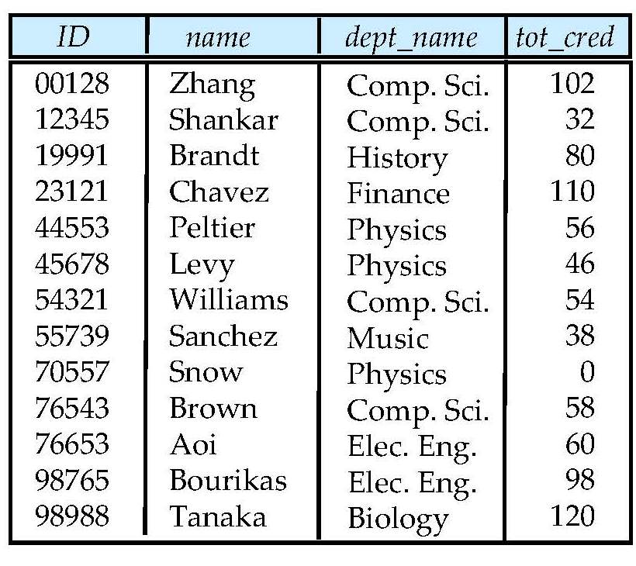
Student Relation

Slide 11
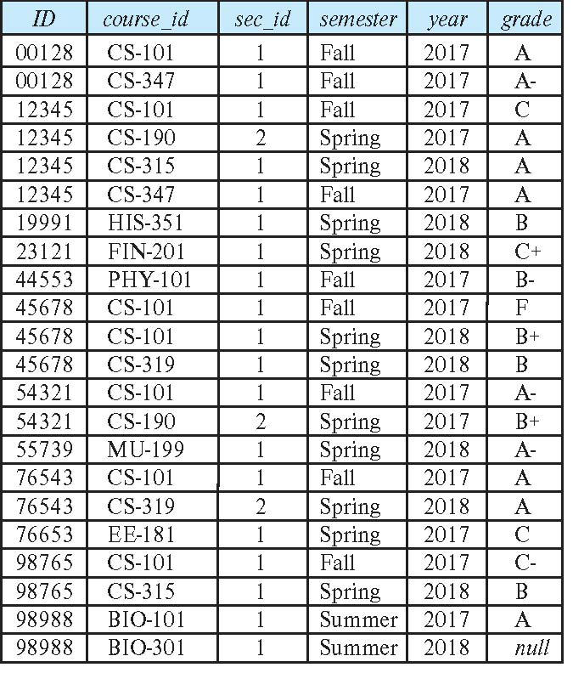
Takes Relation

Slide 12
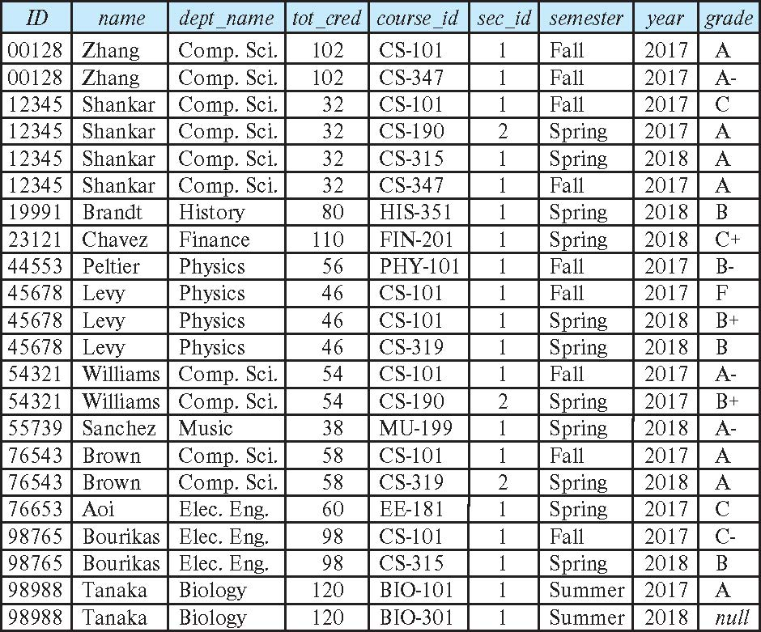
student natural join takes

Slide 13
Dangerous in Natural Join
Beware of unrelated attributes with same name which get equated incorrectly
Example -- List the names of students instructors along with the titles of courses that they have taken
Correct version
select name, title from student natural join takes, course where takes.course_id = course.course_id;
Incorrect version
select name, title from student natural join takes natural join course;
This query omits all (student name, course title) pairs where the student takes a course in a department other than the student's own department.
The correct version (above), correctly outputs such pairs.

Slide 14
Natural Join with Using Clause
To avoid the danger of equating attributes erroneously, we can use the “using” construct that allows us to specify exactly which columns should be equated.
Query example
select name, title from (student natural join takes) join course using (course_id)

Slide 15
Join Condition
The on condition allows a general predicate over the relations being joined
This predicate is written like a where clause predicate except for the use of the keyword on
Query example
select * from student join takes on student_ID = takes_ID
The on condition above specifies that a tuple from student matches a tuple from takes if their ID values are equal.
Equivalent to:
select * from student , takes where student_ID = takes_ID

Slide 16
Join Condition (Cont.)
The on condition allows a general predicate over the relations being joined.
This predicate is written like a where clause predicate except for the use of the keyword on.
Query example
select * from student join takes on student_ID = takes_ID
The on condition above specifies that a tuple from student matches a tuple from takes if their ID values are equal.
Equivalent to:
select * from student , takes where student_ID = takes_ID

Slide 17
JOIN Examples
Switch to notebook.
But, first an aside – Associative Entity (next slides)

Slide 18
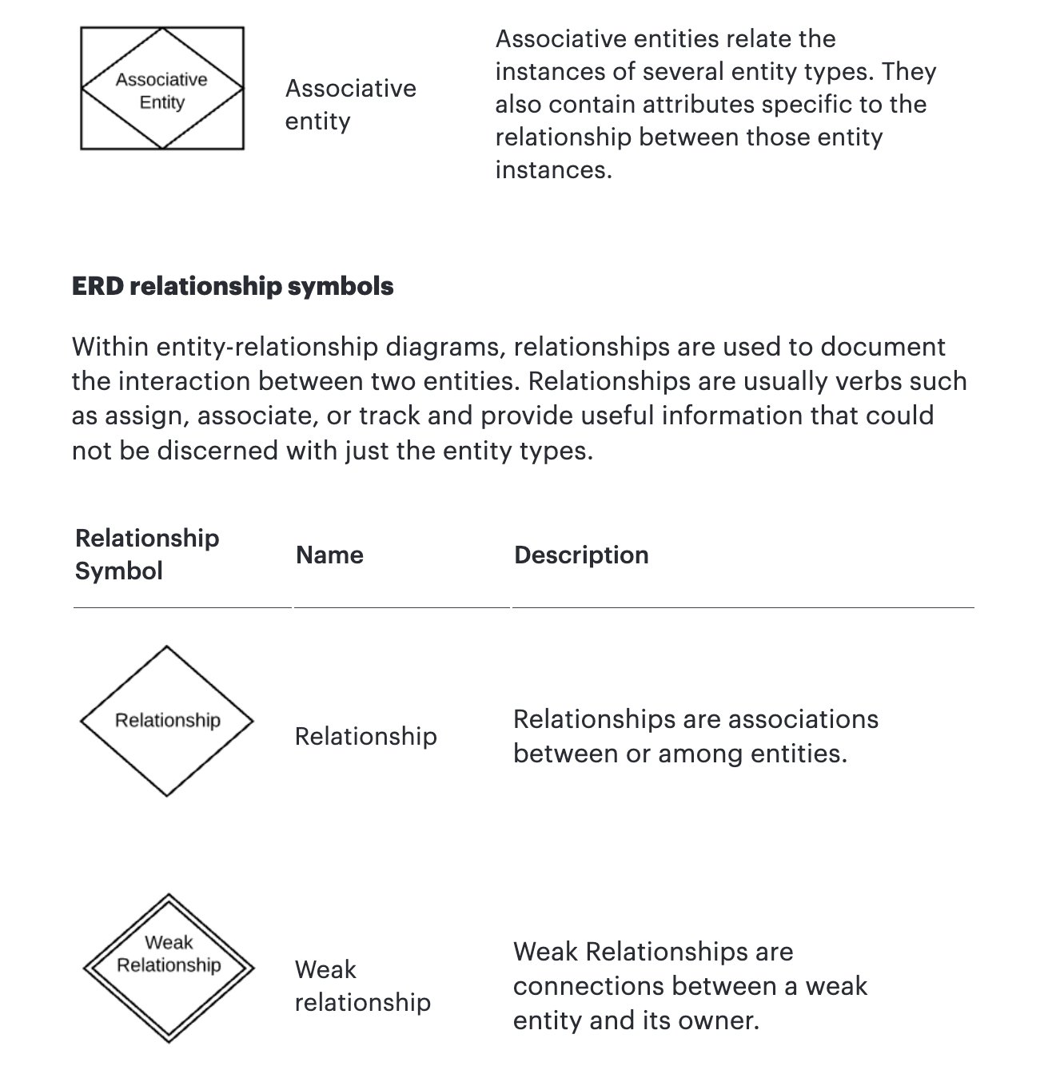
Associative Entity
The ER model represents “associations/relationships” as
First class “things”
That are different from “entities.”
The SQL model does not have “relationships” or associations as first-class types. You have
Tables
Columns
Keys
Constraints
… …
You can implement some “relationships” using foreign keys. Others require something more complex – an associative entity.

Slide 19
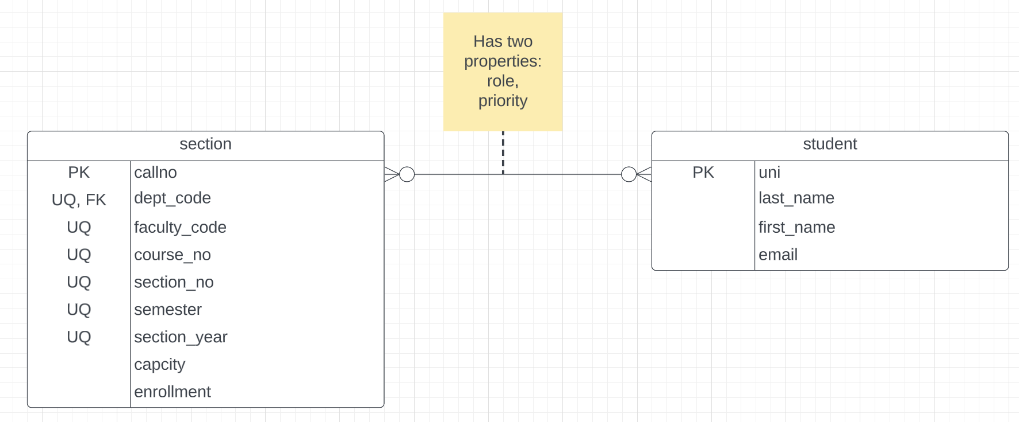
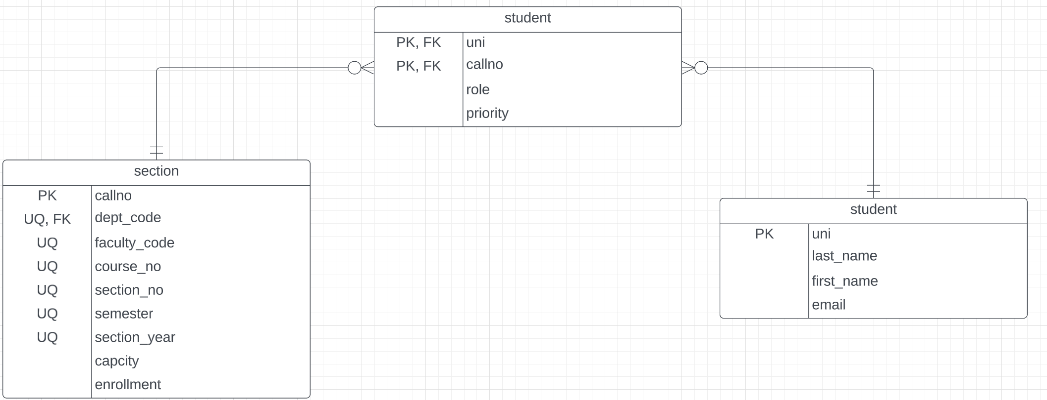
Associative Entity
“An associative entity is a term used in relational and entity–relationship theory. A relational database requires the implementation of a base relation (or base table) to resolve many-to-many relationships. A base relation representing this kind of entity is called, informally, an associative table.” (https://en.wikipedia.org/wiki/Associative_entity)
Consider Students – Sections:
This is many-to-many. There is no way to implement in SQL. You see this in the Advises table in the sample database.
The “relationship/association” has properties that are not attributes of the connected entities.
SQL Realization
Switch to notebook diagram.

Slide 20
Integrity Constraints, Part 1
20 | COMS W4111_002_2023_3: Lecture 4: ER, Relational, SQL (III), Applications © Donald F. Ferguson, 2023

Slide 21
Integrity Constraints
Integrity constraints guard against accidental damage to the database, by ensuring that authorized changes to the database do not result in a loss of data consistency.
A checking account must have a balance greater than $10,000.00
A salary of a bank employee must be at least $4.00 an hour
A customer must have a (non-null) phone number
DFF
Without integrity constraints in the database, maintaining data correctness requires:
Lots of users know what to do and do not make mistakes.
Dozens of programs correctly implement constraints in the code and stay up to date on changes.
Implementing the constraints as part of the schema eliminates many issues.

Slide 22
Constraints on a Single Relation
not null
primary key
unique
check (P), where P is a predicate

Slide 23
Not Null Constraints
not null
Declare name and budget to be not null
name varchar(20) not null budget numeric(12,2) not null

Slide 24
Unique Constraints
unique ( A₁, A₂, …, A_{m})
The unique specification states that the attributes A₁, A₂, …, A_{m} form a candidate key.
Candidate keys are permitted to be null (in contrast to primary keys).

Slide 25
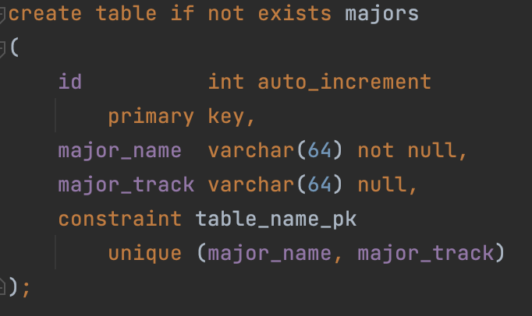
Simple Example
Consider a simple example of an entity class major:
major(id, name, track)
“id” is a uniquely generated ID
“name” is the major name, e.g. “Computer Science,” “Economics,” … …
“track” is a sub-track/specialty within the major, e.g. “Applications,” “AI/ML,” ...
“track” is optional
The combination of (name, track) is unique.
Note: In many DBMS, this automatically creates indices for keys/constraints.
Switch to Notebook.

Slide 26
The check clause
The check (P) clause specifies a predicate P that must be satisfied by every tuple in a relation.
Example: ensure that semester is one of fall, winter, spring or summer
create table section
(course_id varchar (8),
sec_id varchar (8),
semester varchar (6),
year numeric (4,0),
building varchar (15),
room_number varchar (7),
time slot id varchar (4),
primary key (course_id, sec_id, semester, year),
check (semester in ('Fall', 'Winter', 'Spring', 'Summer')))
DFF:
We could handle the semester check with an enum.
Switch to notebook for a slightly different example.

Slide 27
Referential Integrity
Ensures that a value that appears in one relation for a given set of attributes also appears for a certain set of attributes in another relation.
Example: If “Biology” is a department name appearing in one of the tuples in the instructor relation, then there exists a tuple in the department relation for “Biology”.
Let A be a set of attributes. Let R and S be two relations that contain attributes A and where A is the primary key of S. A is said to be a foreign key of R if for any values of A appearing in R these values also appear in S.

Slide 28
Referential Integrity (Cont.)
Foreign keys can be specified as part of the SQL create table statement
foreign key (dept_name) references department
By default, a foreign key references the primary-key attributes of the referenced table.
SQL allows a list of attributes of the referenced relation to be specified explicitly.
foreign key (dept_name) references department (dept_name)

Slide 29
Cascading Actions in Referential Integrity
When a referential-integrity constraint is violated, the normal procedure is to reject the action that caused the violation.
An alternative, in case of delete or update is to cascade
create table course ( (… dept_name varchar(20), foreign key (dept_name) references department on delete cascade on update cascade, . . .)
Instead of cascade we can use :
set null,
set default
DFF:
I do not like using cascade. I think making changes should be explicit.
Other people disagree.
You will get some simple practice on HW or exams.

Slide 30
Indexes Concepts and Examples
30 | COMS W4111_002_2023_3: Lecture 4: ER, Relational, SQL (III), Applications © Donald F. Ferguson, 2023

Slide 31
Index Creation
Many queries reference only a small proportion of the records in a table.
It is inefficient for the system to read every record to find a record with particular value
An index on an attribute of a relation is a data structure that allows the database system to find those tuples in the relation that have a specified value for that attribute efficiently, without scanning through all the tuples of the relation.
We create an index with the create index command
create index <name> on <relation-name> (attribute);

Slide 32
Index Creation Example
create table student (ID varchar (5), name varchar (20) not null, dept_name varchar (20), tot_cred numeric (3,0) default 0, primary key (ID))
create index studentID_index on student(ID)
The query:
select * from student where ID = '12345'
can be executed by using the index to find the required record, without looking at all records of student
DFF:
An index on (column1, column2, column3)
Is also an index on (column1) and (column1, column2)
But not (column2), (column3), (column2, column3).
We will see “why” later in the semester.

Slide 33
Subqueries Concepts and Examples (Including Set Membership)
33 | COMS W4111_002_2023_3: Lecture 4: ER, Relational, SQL (III), Applications © Donald F. Ferguson, 2023

Slide 34
Nested Subqueries
SQL provides a mechanism for the nesting of subqueries. A subquery is a select-from-where expression that is nested within another query.
The nesting can be done in the following SQL query select A₁, A₂, ..., A_{n} from r₁, r₂, ..., r_{m} where P
as follows:
From clause: r_{i} can be replaced by any valid subquery
Where clause: P can be replaced with an expression of the form:
B <operation> (subquery)
B is an attribute and <operation> to be defined later.
Select clause:
A_{i} can be replaced be a subquery that generates a single value.
Note:
This is a little cryptic.
I think I know what they mean.
There are some operations we will see later in the material, e.g IN, EXISTS, ... ...

Slide 35
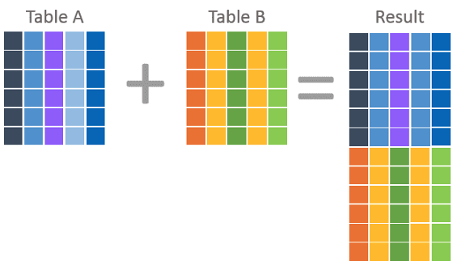
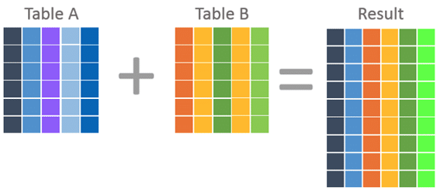
Nested Subquery
The slides that come with the book have surprisingly little material on nested subqueries.
The concept is:
Extremely important.
Students often find subqueries more confusing than joins.
The relationship/difference of subqueries to joins is often, initial unclear.
We have seen:
Union sort of puts a table on top of a table.
Join puts tables sort of puts tables side-by-side.
Subquery enables one query to call another during execution like a subfunction.

Slide 36
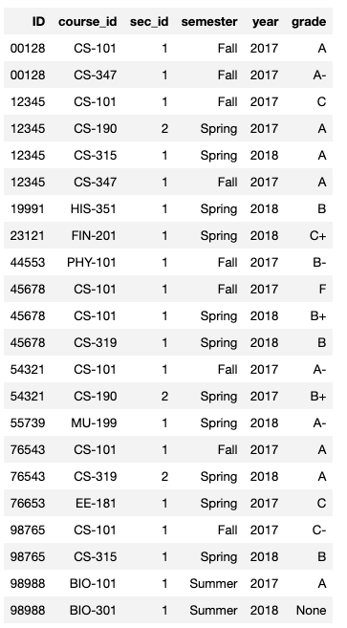
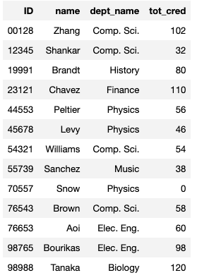
Consider Some Tables
Student
Takes

Slide 37
Consider a Subquery Tables
select *, (select name from student where student.id=takes.id) as name from takes;
Takes
Assume I wrote a function find_student_name(x)
Input is an x
Loops through all students and returns students with student.ID = x.
The query with a subquery above is like:
result = []
For t in takes:
new_r = t + find_student_name(t.id)
result.append(new_r)
Switch to Notebook
Student

Slide 38
Nested Subqueries
SQL provides a mechanism for the nesting of subqueries. A subquery is a select-from-where expression that is nested within another query.
The nesting can be done in the following SQL query select A₁, A₂, ..., A_{n} from r₁, r₂, ..., r_{m} where P
as follows:
From clause: r_{i} can be replaced by any valid subquery
Where clause: P can be replaced with an expression of the form:
B <operation> (subquery)
B is an attribute and <operation> to be defined later.
Select clause:
A_{i} can be replaced be a subquery that generates a single value.
Note: Subquery MUST return
A single scalar if in the SELECT.
A Table if in the FROM.
If in the WHERE:
Either a scalar or a table.
Depending on the operation.

Slide 39
Set Membership

Slide 40
Set Membership
Find courses offered in Fall 2017 and in Spring 2018
Find courses offered in Fall 2017 but not in Spring 2018
select distinct course_id
from section
where semester = 'Fall' and year= 2017 and course_id in (select course_id
from section
where semester = 'Spring' and year= 2018);
select distinct course_id
from section
where semester = 'Fall' and year= 2017 and course_id not in (select course_id
from section
where semester = 'Spring' and year= 2018);

Slide 41
Set Membership (Cont.)
Name all instructors whose name is neither “Mozart” nor Einstein”
select distinct name
from instructor
where name not in ('Mozart', 'Einstein')
Find the total number of (distinct) students who have taken course sections taught by the instructor with ID 10101
Note: Above query can be written in a much simpler manner. The formulation above is simply to illustrate SQL features
select count (distinct ID)
from takes
where (course_id, sec_id, semester, year) in (select course_id, sec_id, semester, year
from teaches
where teaches.ID= 10101);

Slide 42
Set Comparison

Slide 43
Set Comparison – “some” Clause
Find names of instructors with salary greater than that of some (at least one) instructor in the Biology department.
Same query using > some clause
select distinct T.name
from instructor as T, instructor as S
where T.salary > S.salary and S.dept name = 'Biology';
select name
from instructor
where salary > some (select salary
from instructor
where dept name = 'Biology');

Slide 44
Definition of “some” Clause
F <comp> some r ⇔ ∃ t ∈ r such that (F <comp> t ) Where <comp> can be: <, ≤, >, =, ≠
0
(5 < some
5
) = true
(read: 5 < some tuple in the relation)
6
0
(5 < some
5
) = false
0
(5 = some
) = true
5
0
(5 ≠ some
5
) = true (since 0 ≠ 5)
(= some) ≡ in
However, (≠ some) ≡ not in

Slide 45
Set Comparison – “all” Clause
Find the names of all instructors whose salary is greater than the salary of all instructors in the Biology department.
select name
from instructor
where salary > all (select salary
from instructor
where dept name = 'Biology');

Slide 46
Definition of “all” Clause
F <comp> all r ⇔ ∀ t ∈ r (F <comp> t)
0
(5 < all
5
) = false
6
6
(5 < all
) = true
10
4
(5 = all
) = false
5
4
(5 ≠ all
) = true (since 5 ≠ 4 and 5 ≠ 6)
6
(≠ all) ≡ not in
However, (= all) ≡ in

Slide 47
Test for Empty Relations
The exists construct returns the value true if the argument subquery is nonempty.
exists r ⇔ r ≠ Ø
not exists r ⇔ r = Ø

Slide 48
Use of “exists” Clause
Yet another way of specifying the query “Find all courses taught in both the Fall 2017 semester and in the Spring 2018 semester”
select course_id from section as S where semester = 'Fall' and year = 2017 and exists (select * from section as T where semester = 'Spring' and year= 2018 and S.course_id = T.course_id);
Correlation name – variable S in the outer query
Correlated subquery – the inner query

Slide 49
Use of “not exists” Clause
Find all students who have taken all courses offered in the Biology department.
Note that X – Y = Ø ⇔ X ⊆ Y
Note: Cannot write this query using = all and its variants
select distinct S.ID, S.name
from student as S
where not exists ( (select course_id
from course
where dept_name = 'Biology')
except
(select T.course_id
from takes as T
where S.ID = T.ID));
First nested query lists all courses offered in Biology
Second nested query lists all courses a particular student took

Slide 50
Test for Absence of Duplicate Tuples
The unique construct tests whether a subquery has any duplicate tuples in its result.
The unique construct evaluates to “true” if a given subquery contains no duplicates .
Find all courses that were offered at most once in 2017
select T.course_id from course as T where unique ( select R.course_id from section as R where T.course_id= R.course_id and R.year = 2017);

Slide 51
Subqueries in the From Clause

Slide 52
Subqueries in the Form Clause
SQL allows a subquery expression to be used in the from clause
Find the average instructors’ salaries of those departments where the average salary is greater than $42,000.”
select dept_name, avg_salary from ( select dept_name, avg (salary) as avg_salary from instructor group by dept_name) where avg_salary > 42000;
Note that we do not need to use the having clause
Another way to write above query
select dept_name, avg_salary from ( select dept_name, avg (salary) from instructor group by dept_name)
as dept_avg (dept_name, avg_salary)
where avg_salary > 42000;

Slide 53
With Clause
The with clause provides a way of defining a temporary relation whose definition is available only to the query in which the with clause occurs.
Find all departments with the maximum budget with max_budget (value) as (select max(budget) from department) select department.name from department, max_budget where department.budget = max_budget.value;

Slide 54
Complex Queries using With Clause
Find all departments where the total salary is greater than the average of the total salary at all departments
with dept _total (dept_name, value) as
(select dept_name, sum(salary)
from instructor
group by dept_name),
dept_total_avg(value) as
(select avg(value)
from dept_total)
select dept_name
from dept_total, dept_total_avg
where dept_total.value > dept_total_avg.value;

Slide 55
Scalar Subquery
Scalar subquery is one which is used where a single value is expected
List all departments along with the number of instructors in each department
select dept_name, ( select count(*) from instructor where department.dept_name = instructor.dept_name) as num_instructors from department;
Runtime error if subquery returns more than one result tuple

Slide 56
ER Modeling Design Patterns and Advanced Concepts
56 | COMS W4111_002_2023_3: Lecture 4: ER, Relational, SQL (III), Applications © Donald F. Ferguson, 2023

Slide 57
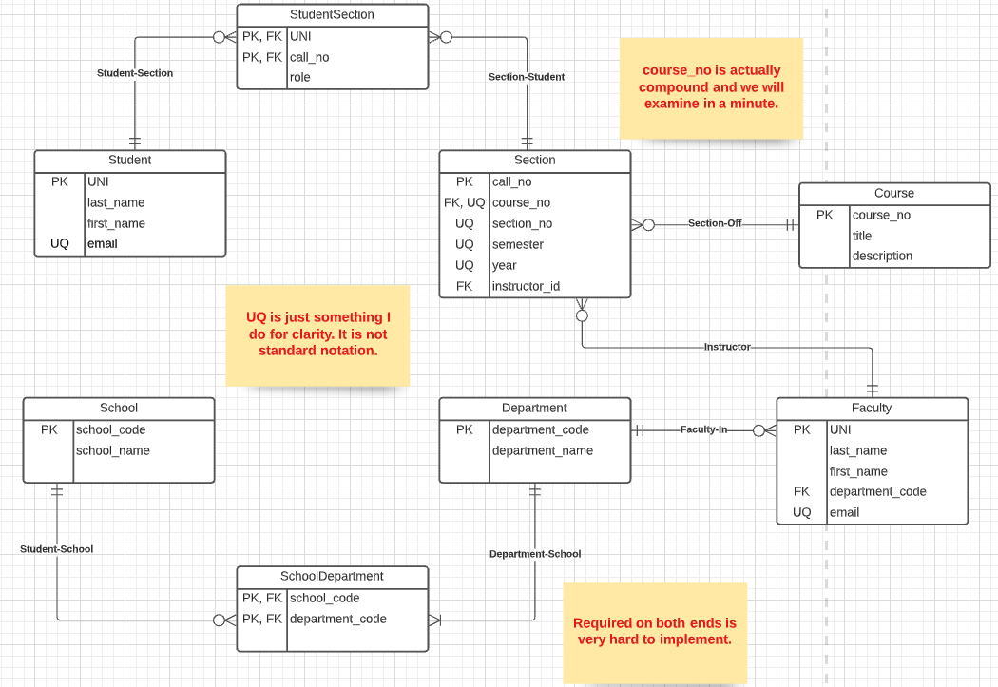
Approximate Model

Slide 58
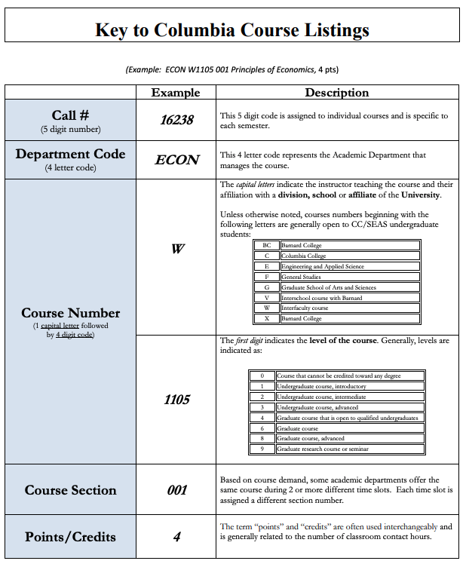
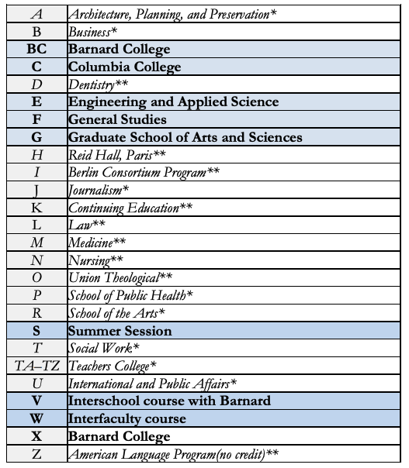
Course Number
https://www.cc-seas.columbia.edu/sites/dsa/files/handbooks/Columbia%20Key%20to%20Course%20Listing.pdf

Slide 59
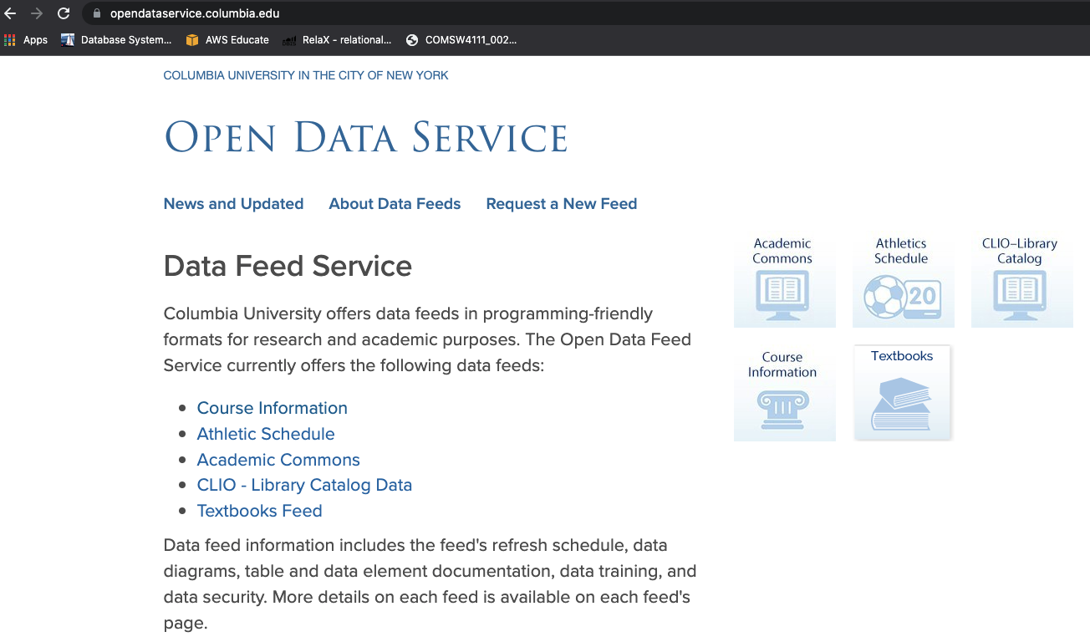
Columbia Open Data Service

Slide 60
Associative Entity
The ER model represents “associations/relationships” as
First class “things”
That are different from “entities.”
The SQL model does not have “relationships” or associations as first class types. You have
Tables
Columns
Keys
Constraints
… …
You can implement some “relationships” using foreign keys. Others require something more complex – an associative entity.

Slide 61
Associative Entity
“An associative entity is a term used in relational and entity–relationship theory. A relational database requires the implementation of a base relation (or base table) to resolve many-to-many relationships. A base relation representing this kind of entity is called, informally, an associative table.” (https://en.wikipedia.org/wiki/Associative_entity)
Consider Students – Sections:
This is many-to-many. There is not way to implement in SQL. You see this in the Advises table in the sample database.
The “relationship/association” has properties that are not attributes of the connected entities.
SQL Realization
Switch to notebook diagram.

Slide 62
More Relational Algebra
62 | COMS W4111_002_2023_3: Lecture 4: ER, Relational, SQL (III), Applications © Donald F. Ferguson, 2023

Slide 63
What are all those other Symbols?
Some of the operators are useful and “common,” but not always considered part of the core algebra.
Some of these are pretty obscure
Division
Anti-Join
Left semi-join
Right semi-join
Most SQL engines do not support them.
You can implement them using combinations of JOIN, SELECT, WHERE, ... ...
But, I cannot every remember using them in applications I have developed.
Outer JOIN is very useful, but less common. We will cover.
There are also some “patterns” or “terms”
Equijoin
Non-equi join
Natural join
Theta join
... ...
I may ask you to define these terms on some exams or the obscure operatorsbecause they may be common internships/job interview questions.
τ order by
γ group by
¬ negation
÷ set division
⨝ natural join, theta-join
⟕ left outer join
⟖ right outer join
⟗ full outer join
⋉ left semi join
⋊ right semi join
▷ anti-join

Slide 64
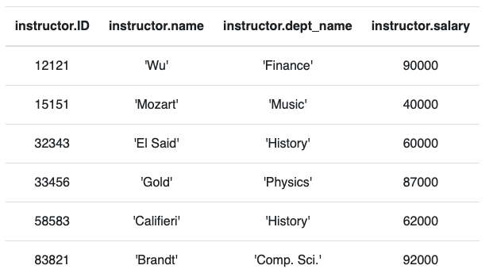
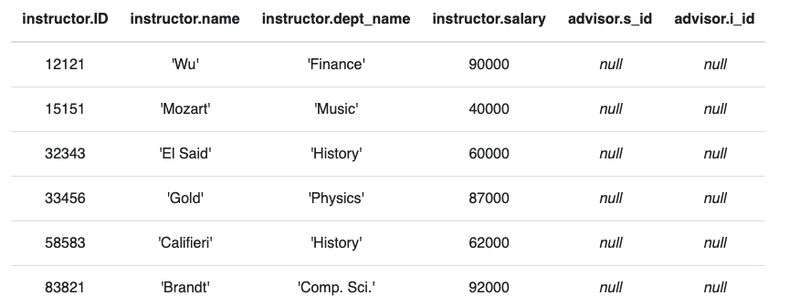
Anti – Join
“An anti-join is when you would like to keep all of the records in the original table except those records that match the other table.”
instructor ▷ ID=i_id advisor
σ i_id=null (instructor ⟕ ID=i_id advisor)

Slide 65
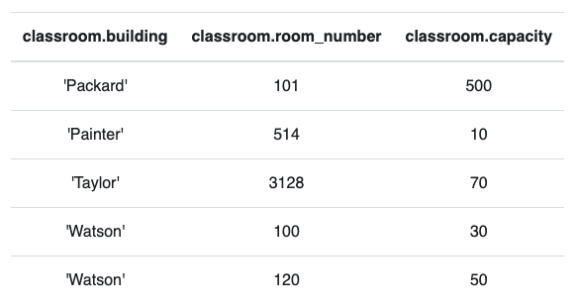
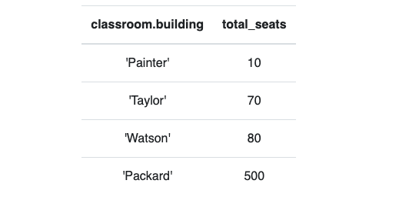
Group By, Order By
classroom
These are very simple examples.
We can apply them to relations created by operations on other tables.
τ total_seats (γ building; sum(capacity)→total_seats (classroom))

Slide 66
REST
66 | COMS W4111_002_2023_3: Lecture 4: ER, Relational, SQL (III), Applications © Donald F. Ferguson, 2023

Slide 67
Data Modeling Concepts and REST
Almost any data model has the same core concepts:
Types and instances:
Entity Type: A definition of a type of thing with properties and relationships.
Entity Instance: A specific instantiation of the Entity Type
Entity Set Instance: An Entity Type that:
Has properties and relationships like any entity, but ...
Has at least one special relationship – contains.
Operations, minimally CRUD, that manipulate entity types and instances:
Create
Retrieve
Update
Delete
Reference/Identify/... ...

Slide 68
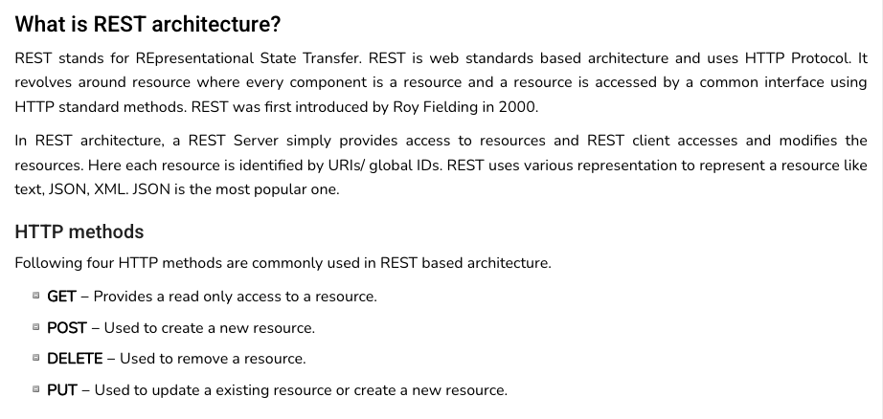
REST (https://www.tutorialspoint.com/restful/restful_introduction.htm)

Slide 69
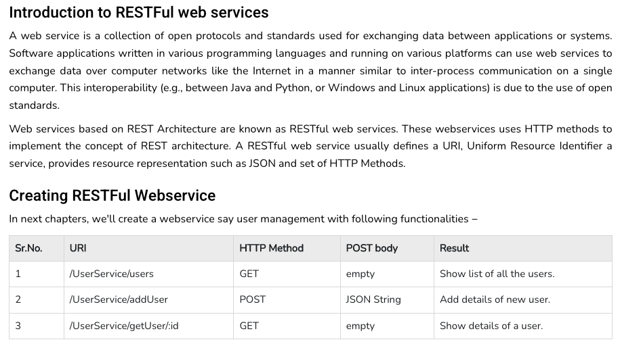
REST (https://www.tutorialspoint.com/restful/restful_introduction.htm)

Slide 70
REST and Resources

Slide 71
URLs

Slide 72
jdbc:mysql://columbia-examples.ckkqqktwkcji.us-east-1.rds.amazonaws.com:3306

Slide 73
Simplistic, Conceptual Mapping (Examples)
REST Method | Resource Path | Relational Operation | DB Resource
DELETE | /people | DROP TABLE | people table
POST | /people | INSERT INTO PEOPLE (...) VALUES(...) | people table people row
GET | /people/21 | SHOW KEYS FROM people ...; SELECT * FROM people WHERE playerID= 21 | people row
GET | /people/21/batting | SELECT batting.* FROM people JOIN batting USING(playerID) WHERE playerID=21
GET | /people/21/batting/2004_1 | SELECT batting.* FROM people JOIN batting USING(playerID) WHERE playerID=21 AND yearID=2004 AND stint=1

Slide 74
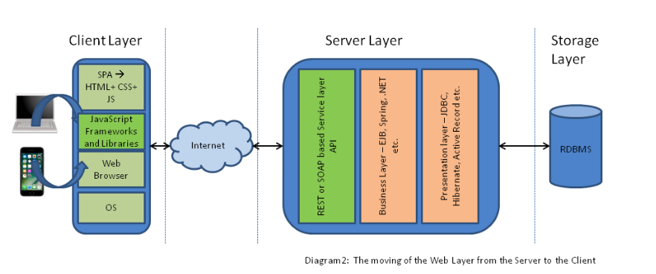
Application Architecture

Slide 75
Walkthrough
Simple web application template.
Calling some cloud APIs.

Slide 76
Data and Visualization (Walk through the data sets and visualizations)
76 | COMS W4111_002_2023_3: Lecture 4: ER, Relational, SQL (III), Applications © Donald F. Ferguson, 2023

